Slide 1
By Arvind Kumar
Continuous Monitoring & Reporting

Slide 2
Agenda
Overview and Introduction
Manual Monitoring
Continuous Monitoring
Types of Monitoring
Monitoring Tools
Advantage of Monitoring

Slide 3
Overview and Introduction
The objective is to conduct ongoing monitoring of the security of an organization’s networks, information and systems.
Proactive: Vulnerability monitoring and asset/device awareness
Detective: Full-view, context-aware threat monitoring, analysis and alerting

Slide 4
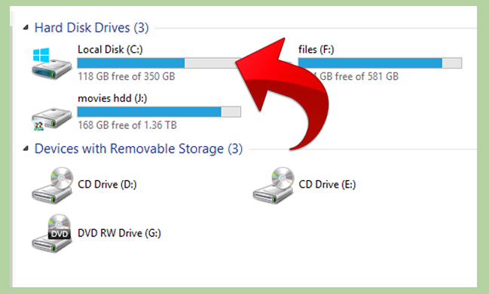
Manual Monitoring
Check Partitions Space

Slide 5
Continuous Monitoring
There are lot of monitoring tools are designed to make sure that a server is active , healthy and responding to request appropriately.
Monitoring tools which lets you check both basic server uptime detailed statistics on all type of servers, including
Webserver application
Database
File servers / Ftp servers
Mail servers
……………..And more other servers used in business.

Slide 6
Types Of Monitoring
Application Monitoring
Server Monitoring
Network Monitoring

Slide 7
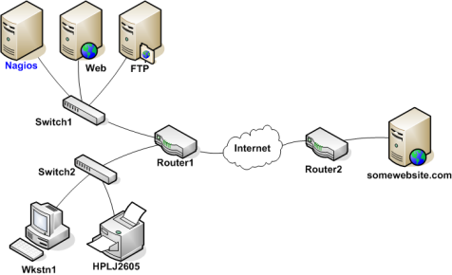
Nagios Workflow

Slide 8
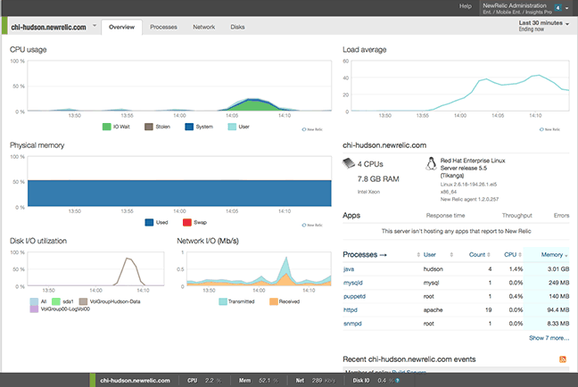
Monitoring Dashboard

Slide 9
Advantage of Monitoring
A fast setup
Notification
Alert
Check in wherever you are
Easy maintenance
Save Time and easy to schedule task

Slide 10

Any Questions?

Slide 11

Continuous Monitoring

Slide 12
Thank You!

